Slide 1
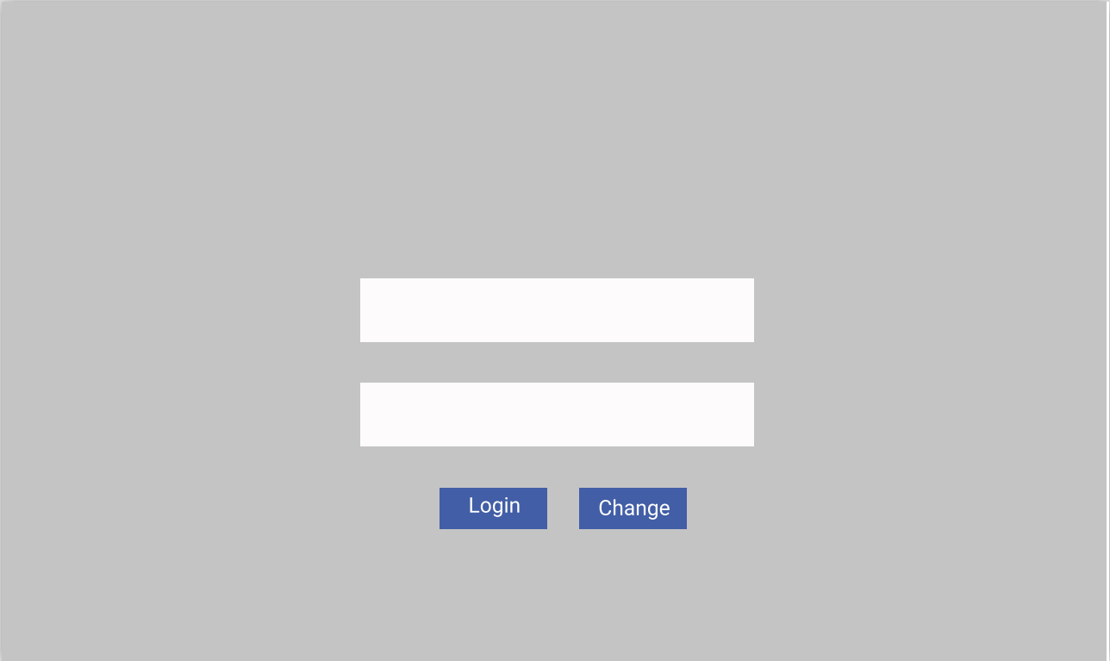
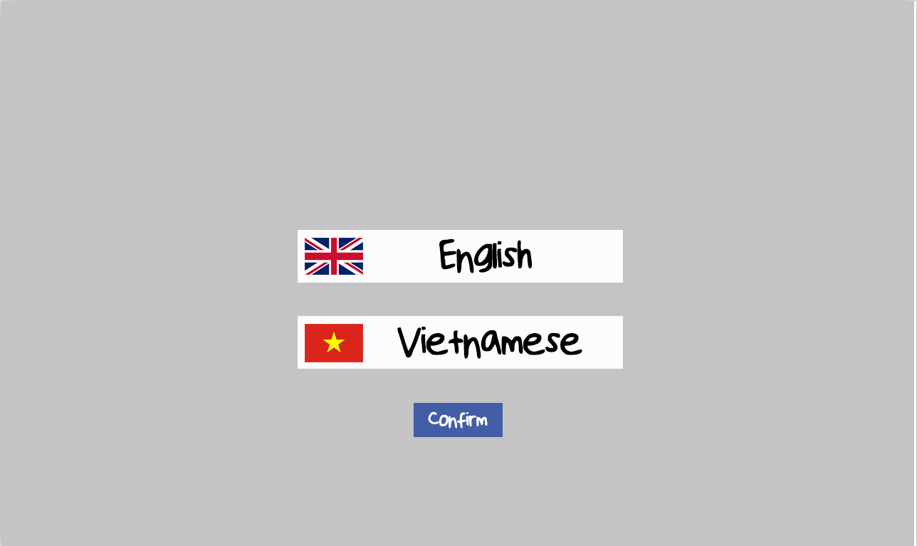
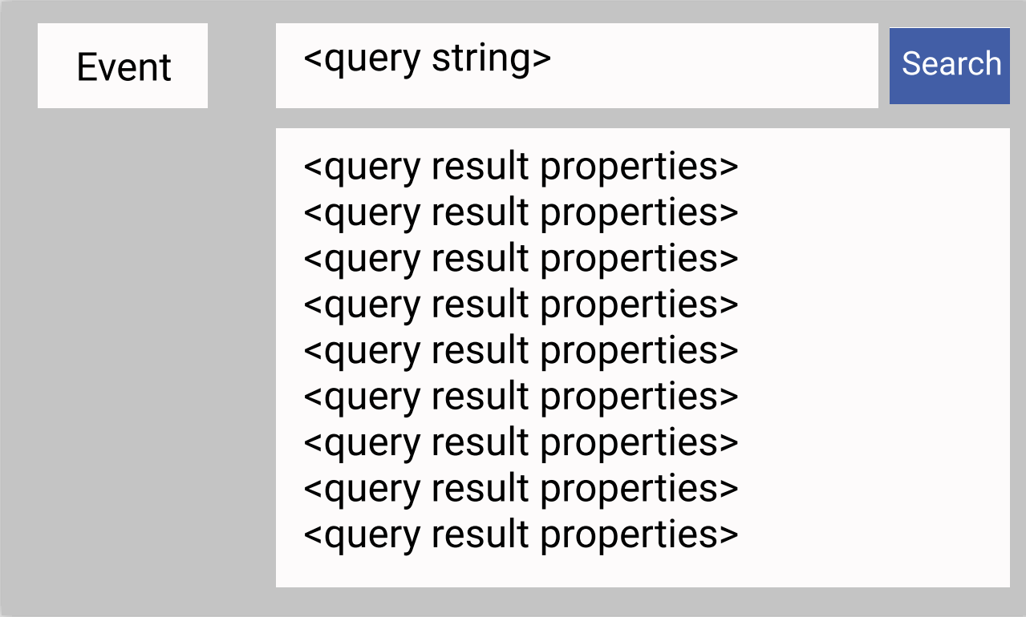
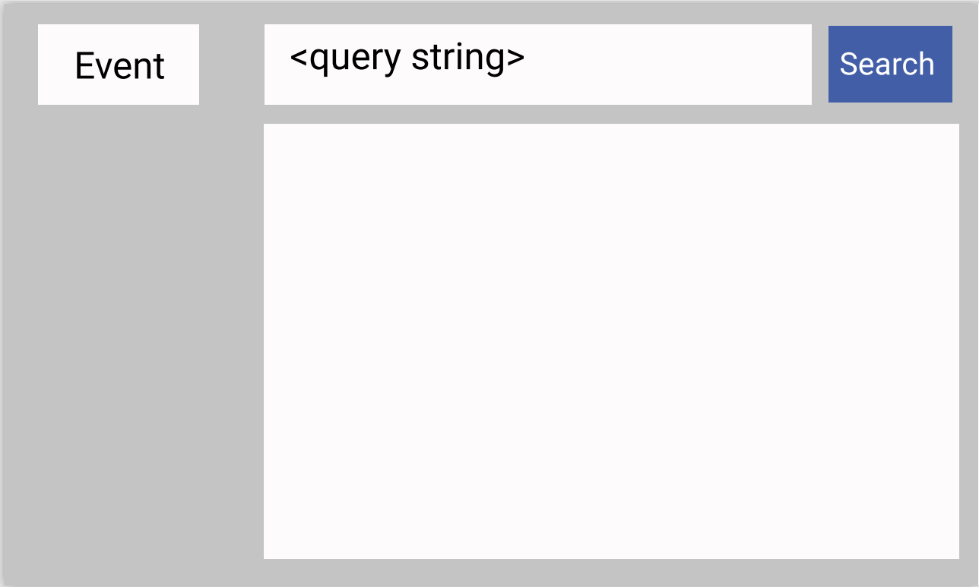
START
END
Example Application: Does not related to any application by any means, do not re-distribute.

Slide 2
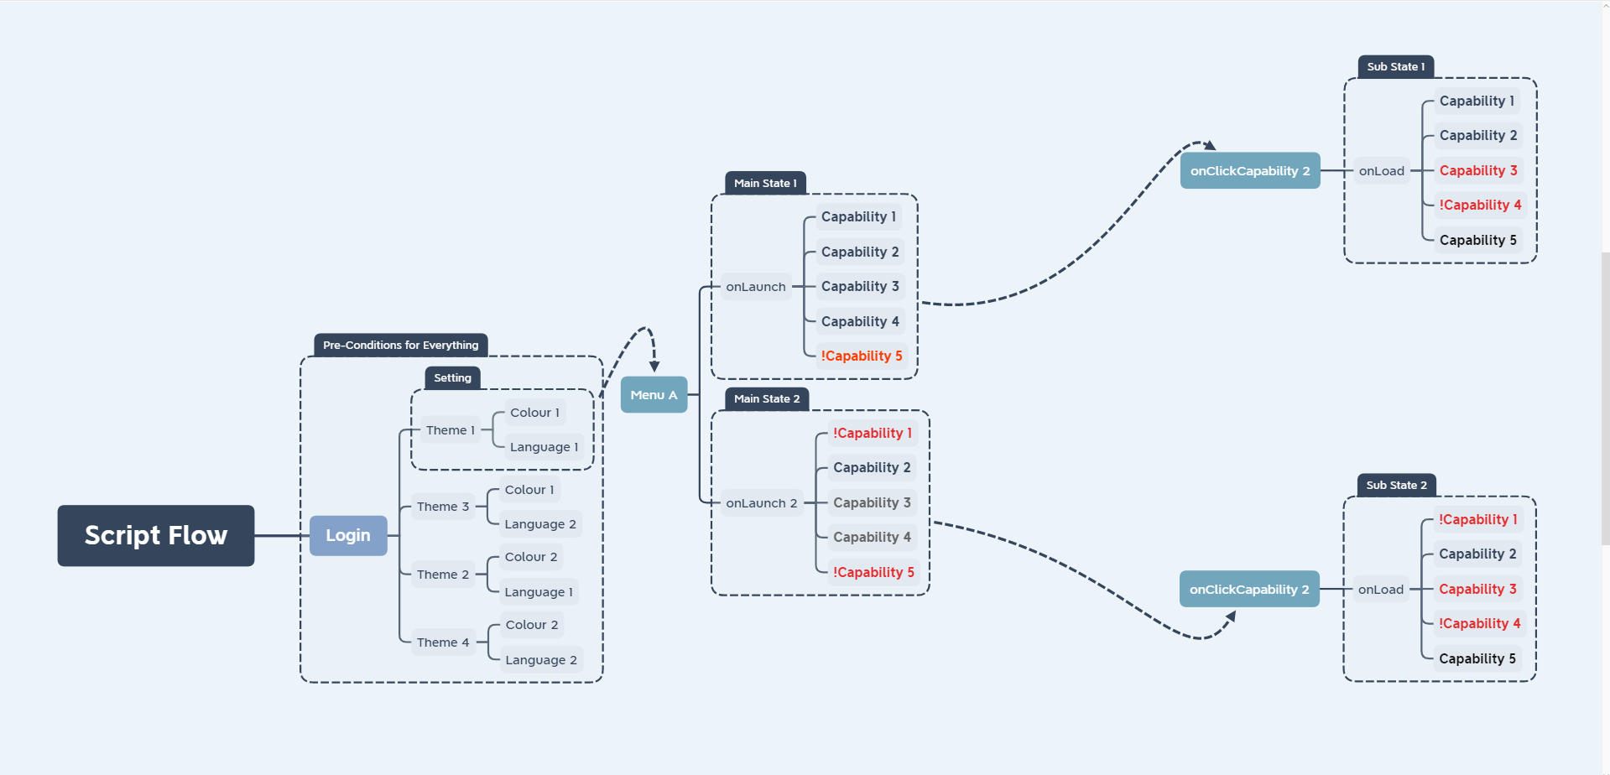
What does this mean?
On main state 1, user logged in with Full Control account, when get get to Menu A, only Capability 5 is inaccessible for him/her.
On main state 2, user logged in with Standard account, when he get to Menu A, Capabilities 1 and 5 is inaccessible for him/her.
How to ensure that our test script cover all Capability?

Slide 3
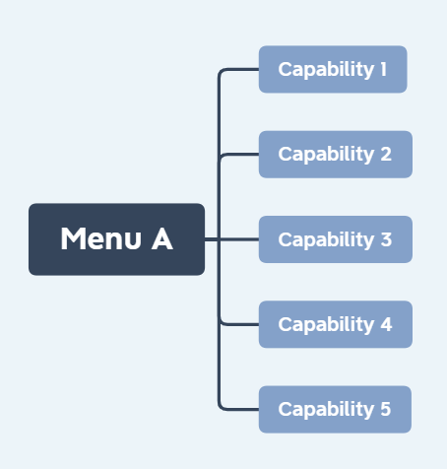
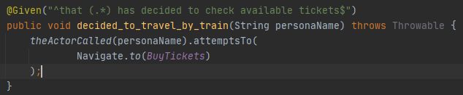
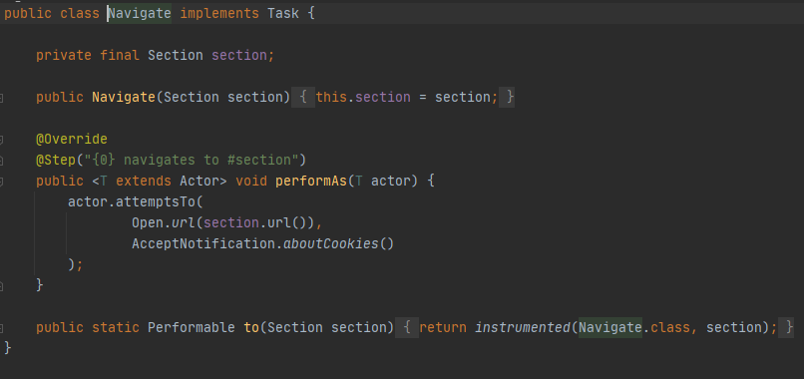
How to ensure that our test script cover all Capability?
Simply make Tasks class to cover all Capabilities, in the following example above, a class to cover 1 task.
Blue group is our Capability Class that we named Navigate,
Green Group is a function that will perform actions using values from Red group,
Red group is a constructor to get value from various sources, in this case an enum file.

Slide 4
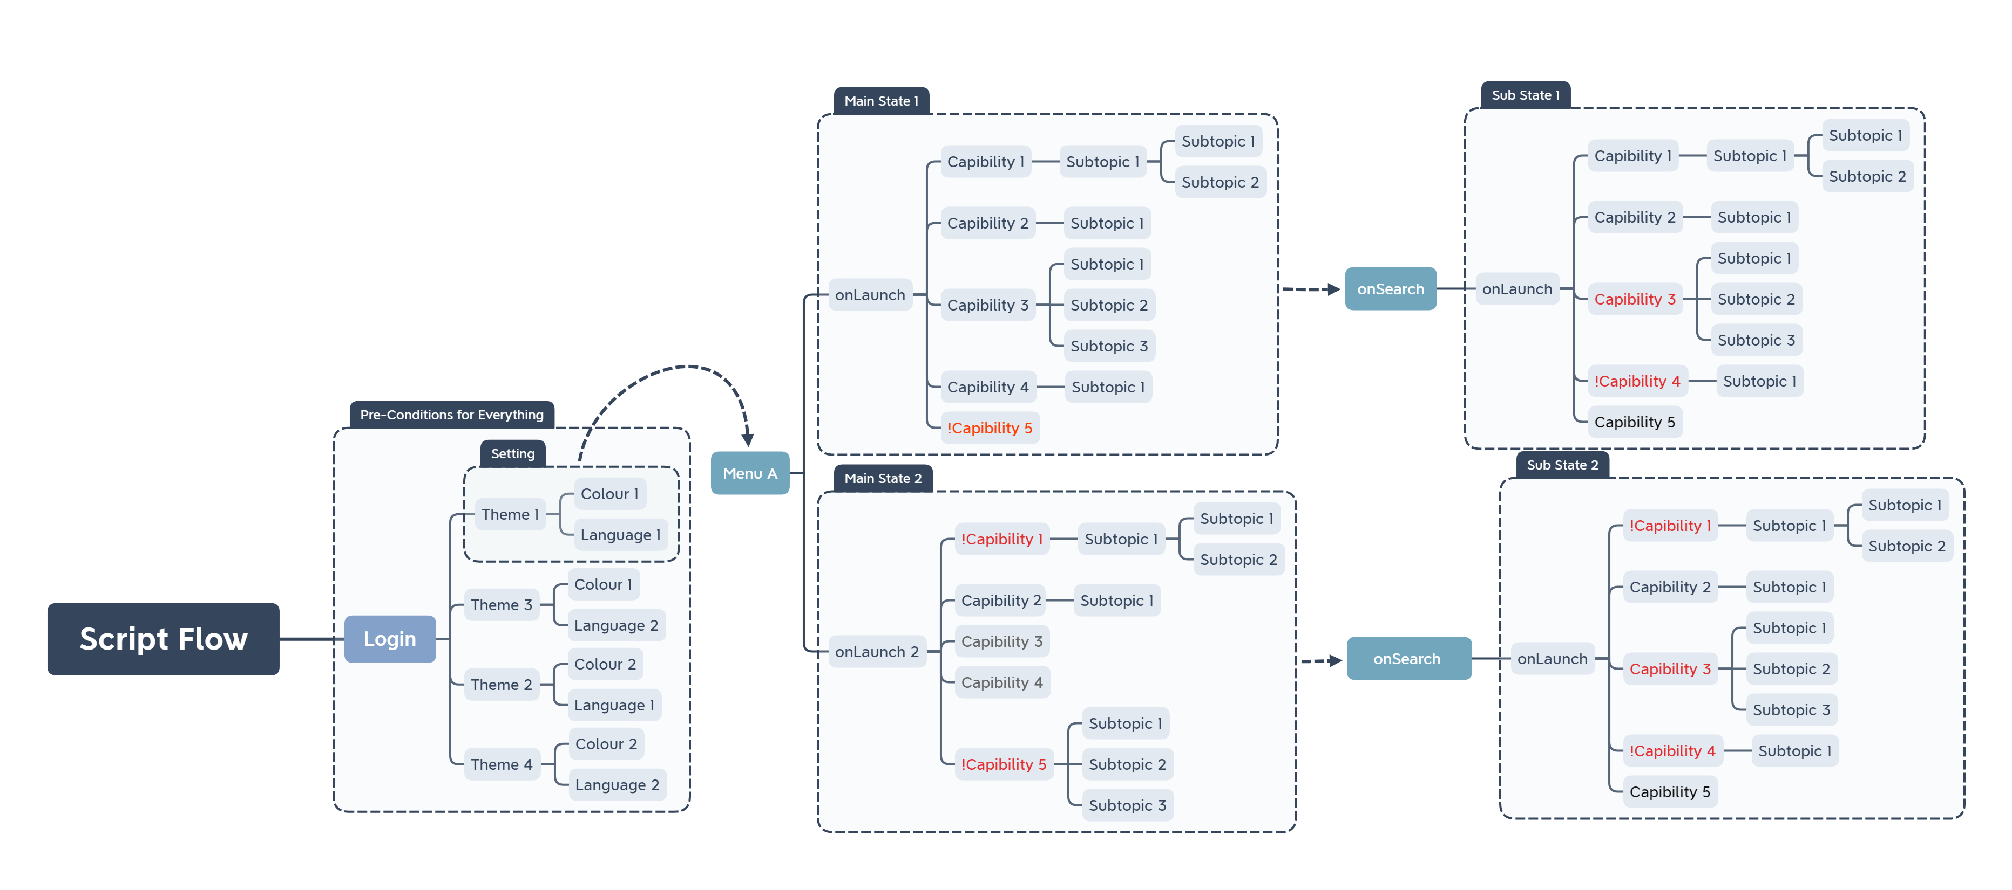
Let scale this up abit by adding sub Capabilities
How will our script handles these sub topic?
Simply Separate our Builders class by Factory them.

Slide 5
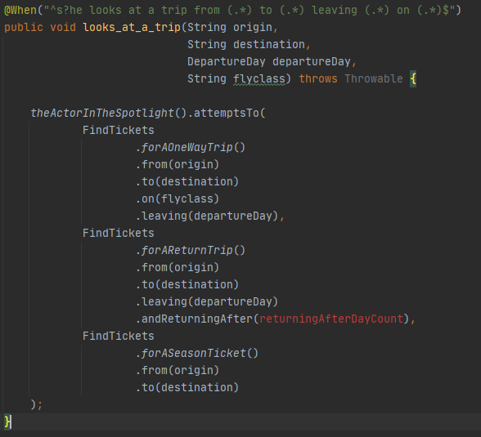
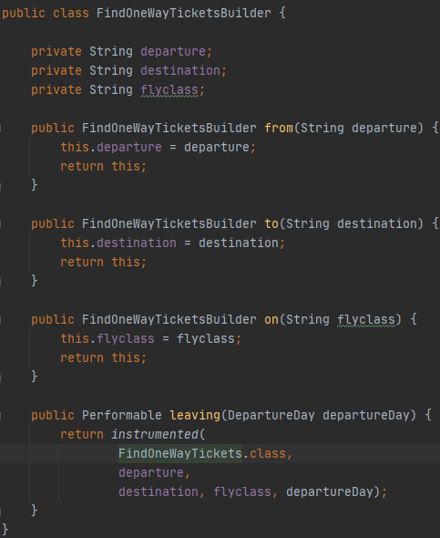
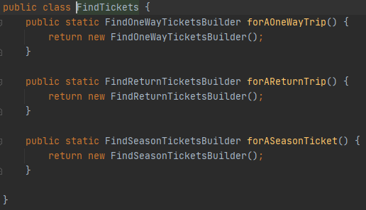
Let see how these work ^
class FindTickets return multiples Builder that serve their specific role.
In this case forAOneWayTrip() will return FindOneWayTicketsBuilder() on the right >
Let see how these work ^
When you get to this point, it's just the same as Page 3.

Slide 6
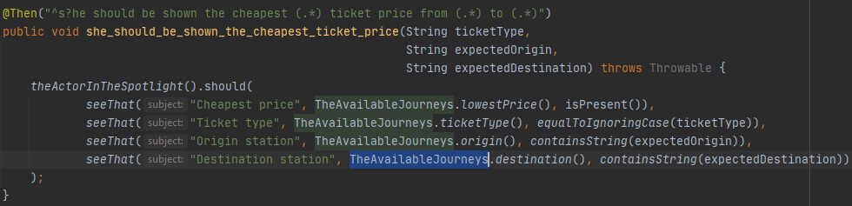
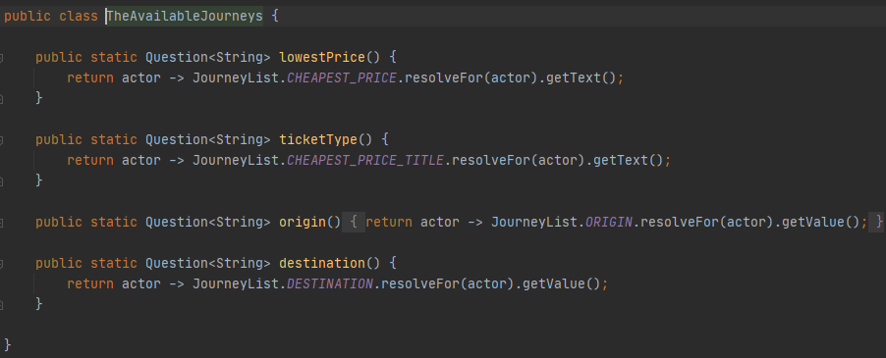
How to prove that the Capibility work like how we expect it to? Use Question Class
Blue group is our Question Class that that share the same ancestry,
Green Group is a function that will return a value from the web driver to compare with red group ie String, Int, Boolean, List, ect
Red group is how we parse values to compare with value we can read from the web driver.

Slide 7
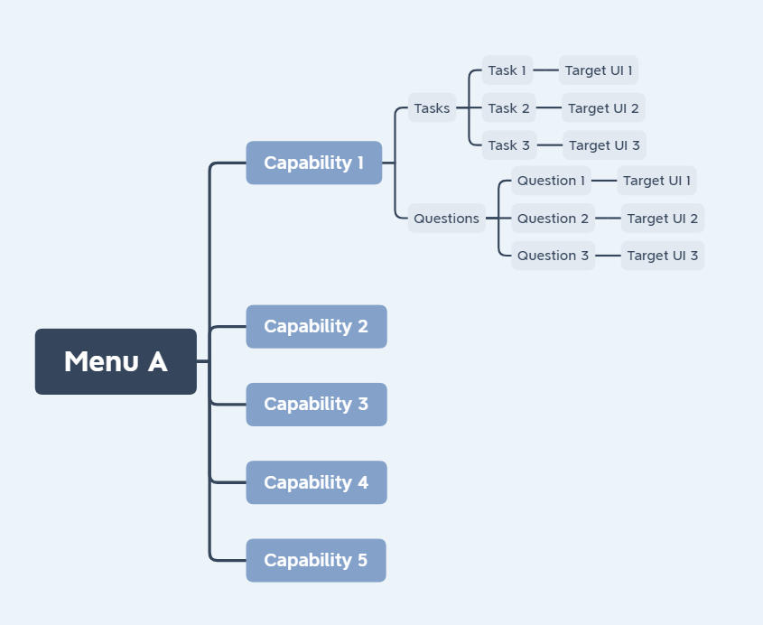
Sum-up
Tasks created based on the Capability, its name will varies from the type, name it as first letter of each word in upper case for example: FindTickets.
Questions created based on the Capability, its name will varies from the type, name it as first letter of each word in upper case for example: TheAvailableX .
How will we save the locator in our current project?

Slide 8
COMMON PAGE OBJECT
START
SPECIFIC PAGE OBJECT
END
Example Application: Does not related to any application by any means, do not re-distribute.

